Slide 1
Network Security Project
HARDEN THE SERVER
BY: Y@h@ck5 +2348140879281

Slide 2
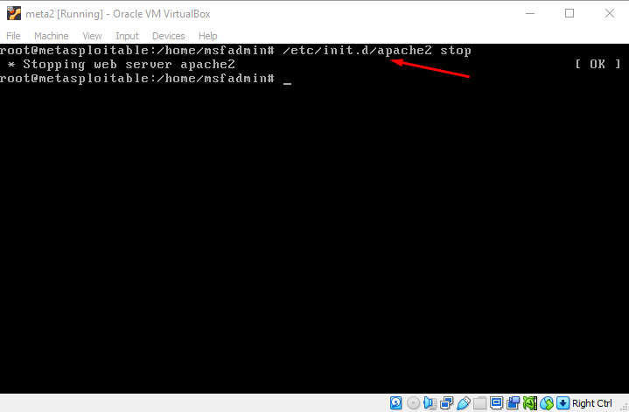
Disable Unused Service
Stop the Apache service on the server as it does not implement an encryption or use a secure ports like 443, using the command /etc/init.d/apache2 stop eliminating the risk.

Slide 3
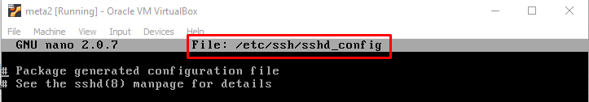
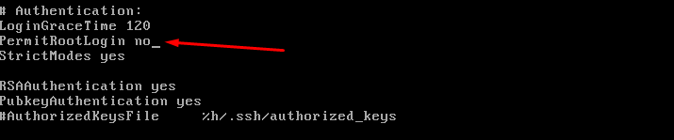
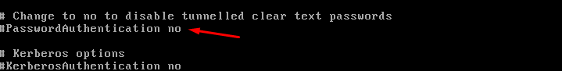
Implement SSH Security
Type the command sudo nano /etc/ssh/sshd_config, and change the following PermitRootLogin and PasswordAuthentication to no as seen in the image.

Slide 4

Restart the SSH Service
After the configuration for SSH have been done as seen in the previous slide, there is need to restart the ssh service. With the command /etc/init.d/ssh restart, restarts the ssh service. This command can also be used to start or stop a service on the server.

Slide 5
THANKS
END

